Slide 1
Predictive Maintenance For Airlines Using IBM Watson Studio
M.Raviteja
GITAM UNIVERSITY

Slide 2
INTRODUCTION
The airport usage currently increased year by year, the traditional method of airport resource allocation has been unable to adapt to the requirements of the operation of the airport.
Dynamic allocation and scheduling of airport terminal passenger service resources are one of the most effective ways to improve passenger service levels and operational efficiency within the terminal, while the relatively accurate passenger traffic forecasting is the prerequisite for dynamic allocation and scheduleing
.In order to cut down the operational cost and also to help engineers by predicting at a faster rate, we make use of Machine Learning (ML).
So the main goal of this project is to build a Machine Learning model to predict the the number of passengers.

Slide 3
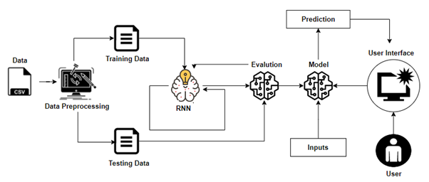
ARCHITECTURE

Slide 4
Project Flow
Machine Learning Model
Data Collection.
Collect the dataset or Create the dataset
Data Preprocessing.
Import the Libraries and the dataset.
Checking for Null Values.
Data Visualization.
Handling Missing Data.
Label encoding And One Hot Encoding.
Feature Scaling.
Splitting Data into Train and Test.
Model Building
Training and testing the model
Evaluation of Model
Application Building
Create an HTML file
Build a Python Code
UI
The user interacts with the UI (User Interface) to enter the data
Entered data is analyzed by the model which is integrated
Once the model analyses the input, the prediction is showcased on the UI

Slide 5

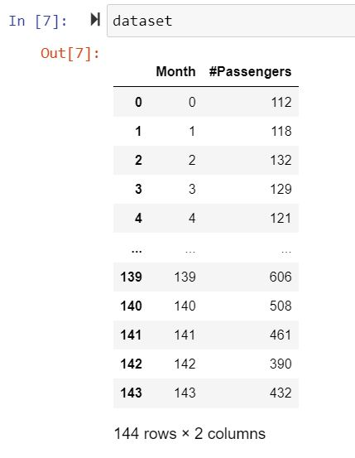
Machine Learning Model
Importing Libraries
Reading the dataset and
Viewing the fields
.

Slide 6
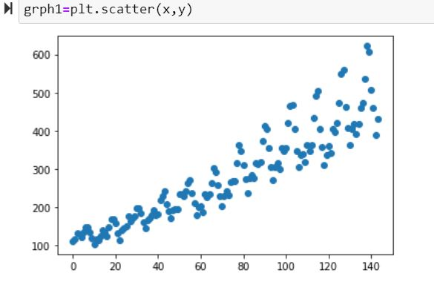
Scatter plot

Slide 7
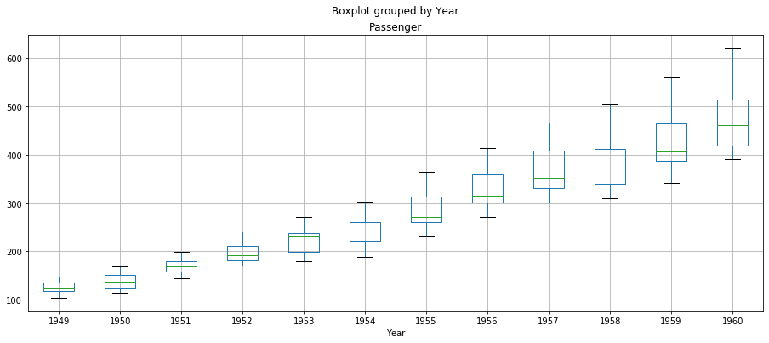

Slide 8
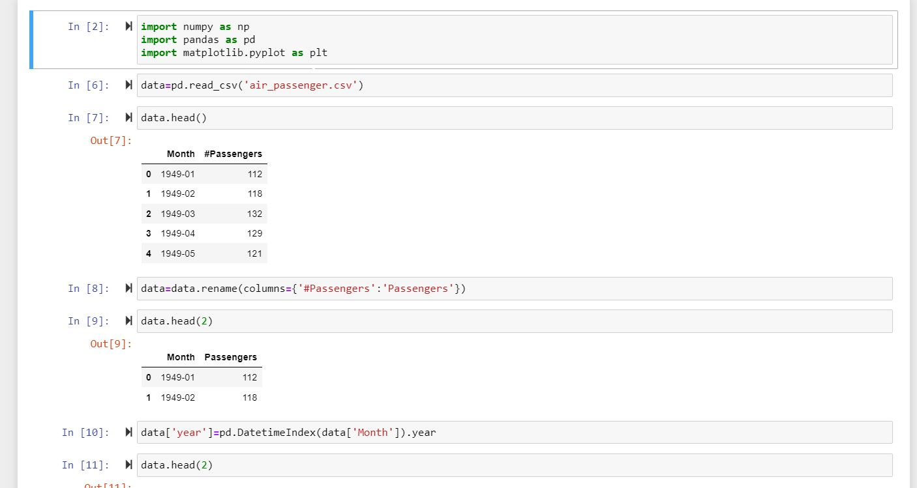

Slide 9
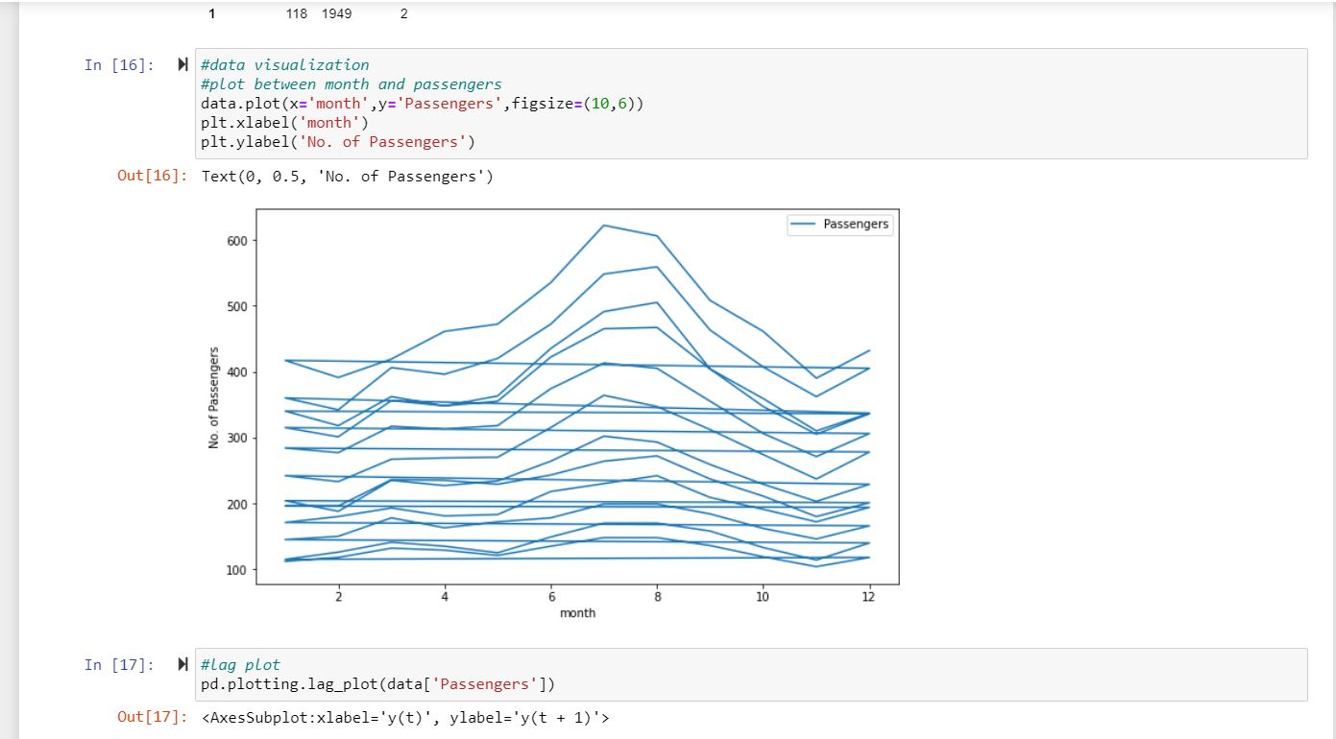

Slide 10
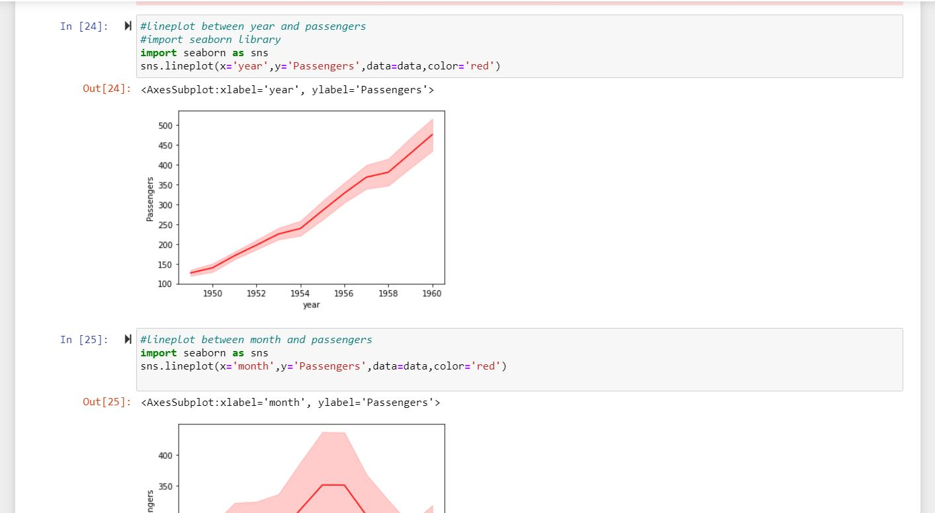

Slide 11
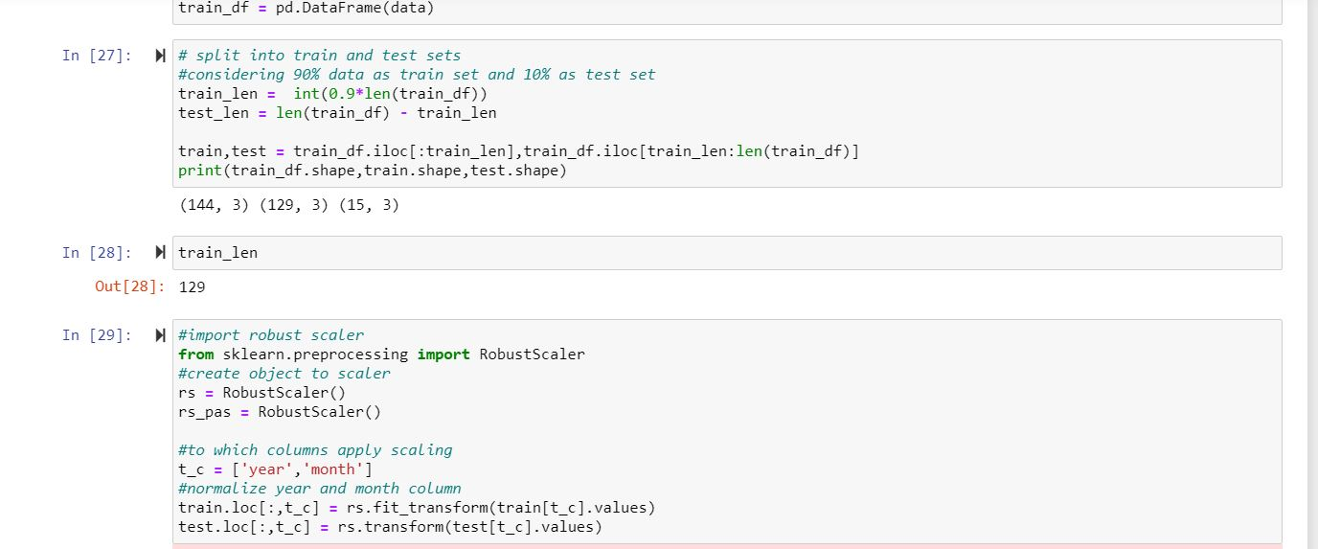
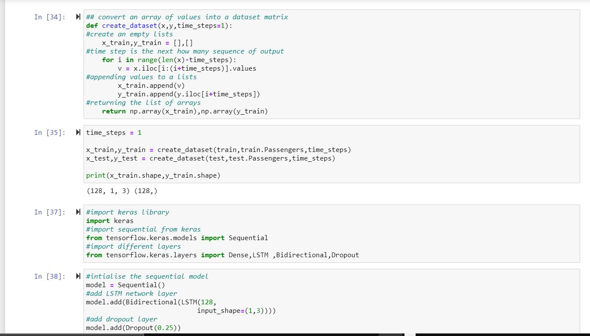

Slide 12
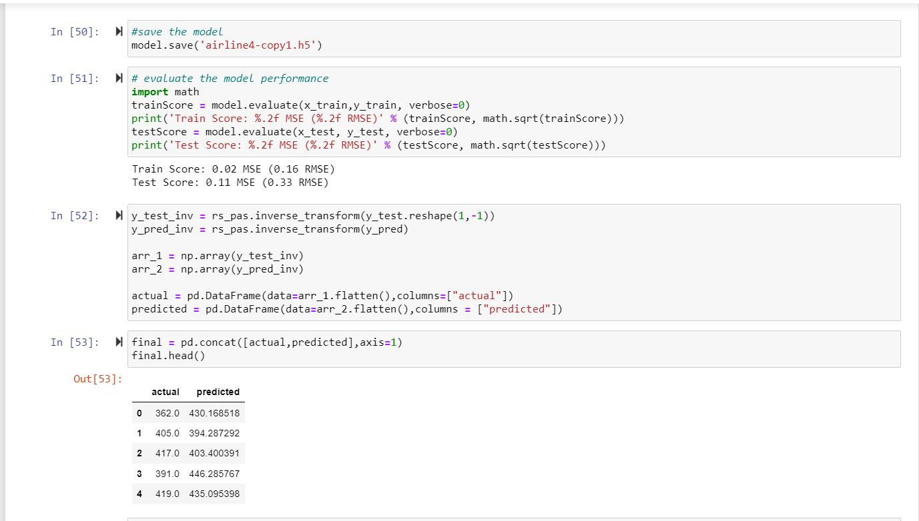

Slide 13
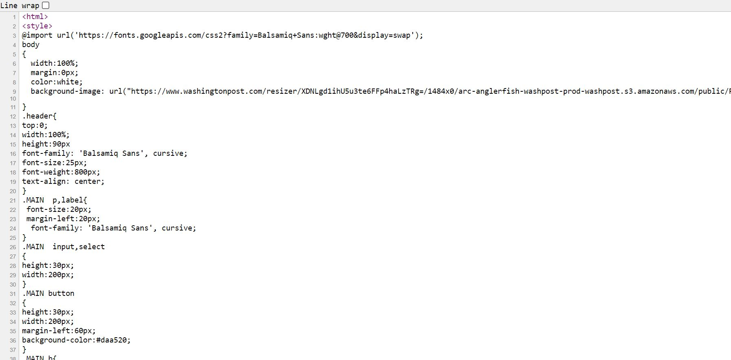
UI
Index ui

Slide 14
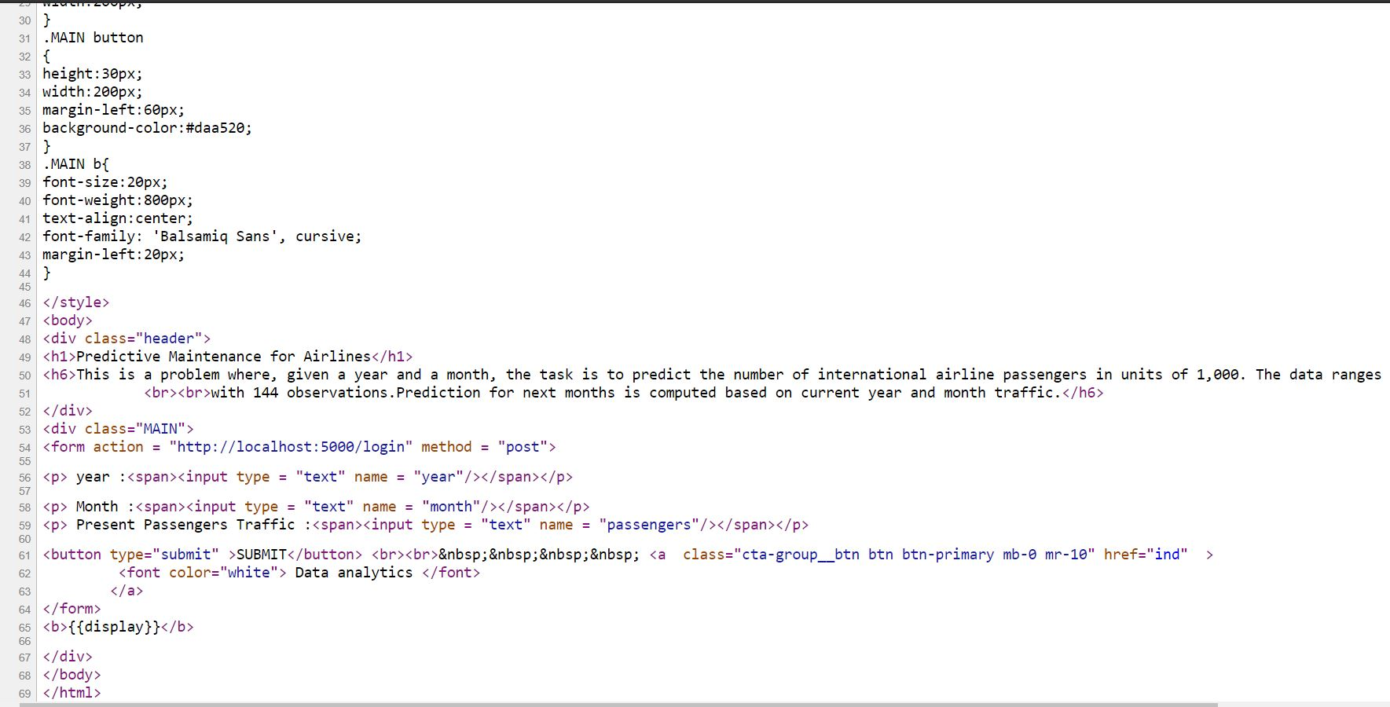

Slide 15
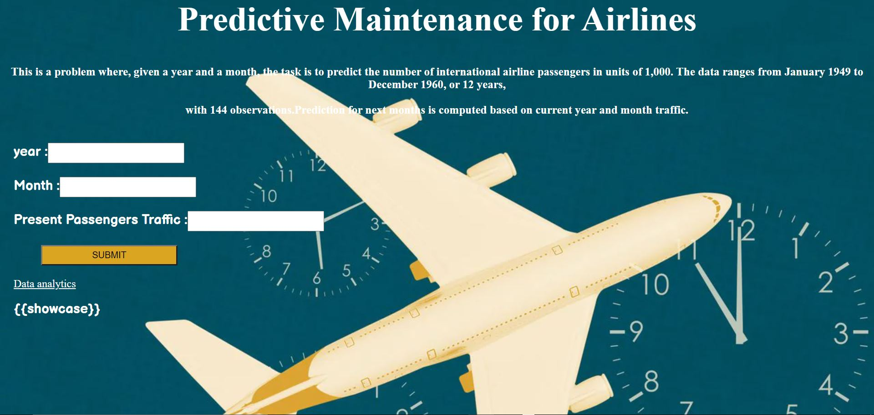
Output UI and the inputs.

Slide 16
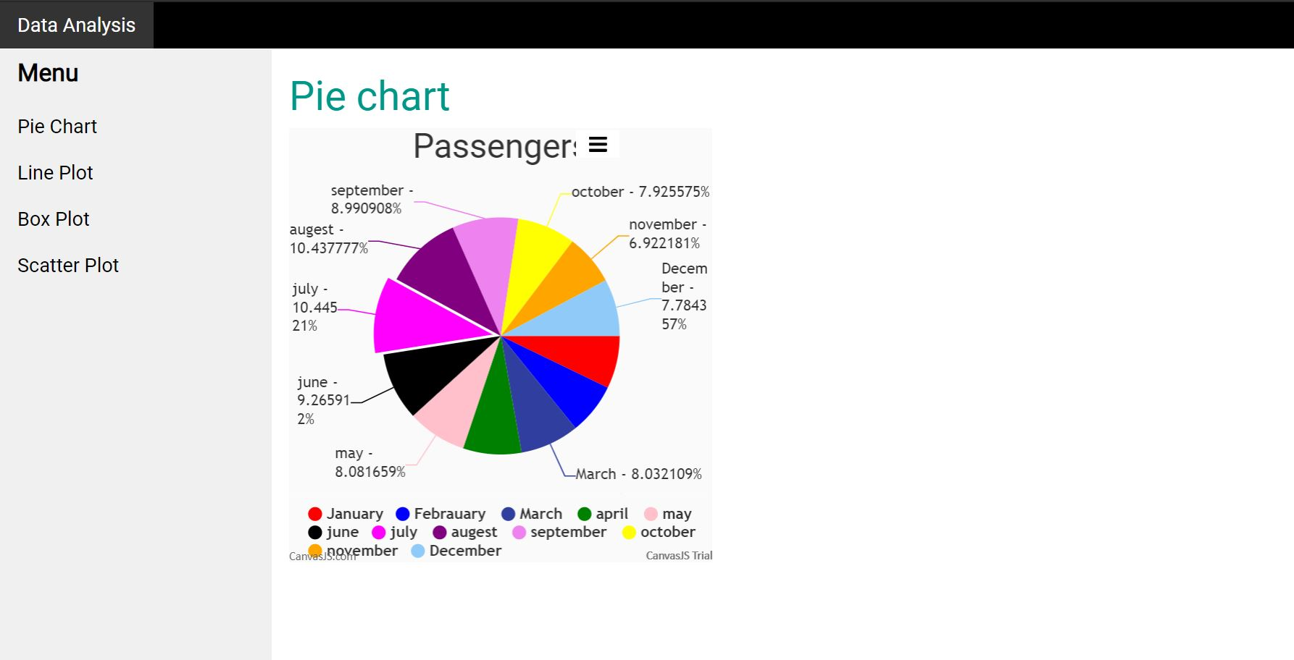
→Predicting The Quality.

Slide 17
Thank
You

